Slide 1
Mini Project - PINN Model
P. Naga Hari Teja - CS19BTECH11021 Vemulapalli Aditya - CS19BTECH11025

Slide 2
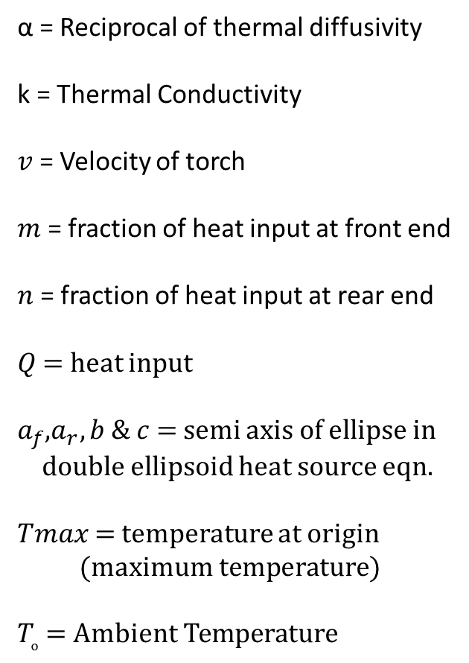

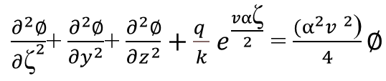
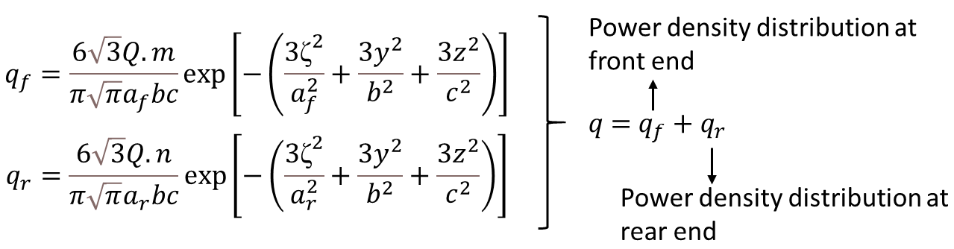
PINN Model
Equations used

Slide 3
Parameter | Notation | Value
Reciprocal of thermal diffusivity | α | 0.0801 s/mm²
Thermal Conductivity | k | 0.05 W/mm K
Velocity of Torch | v | 10 mm/s
Fraction of heat input at front end | m | 0.6
Fraction of heat input at rear end | n | 1.4
Total heat input | Q | 1652.4 W
Semi axis of ellipse | a_f | 1.002 mm
Semi axis of ellipse | a_r | 3.34 mm
Semi axis of ellipse | b | 1.67 mm
Semi axis of ellipse | c | 1.67 mm
Heat transfer coefficient | h | 20 ×10^(-6) W/mm² K
Ambient Temperature | Tₒ | 300.15 K
Maximum Temperature | Ts | 1723 K

Slide 4
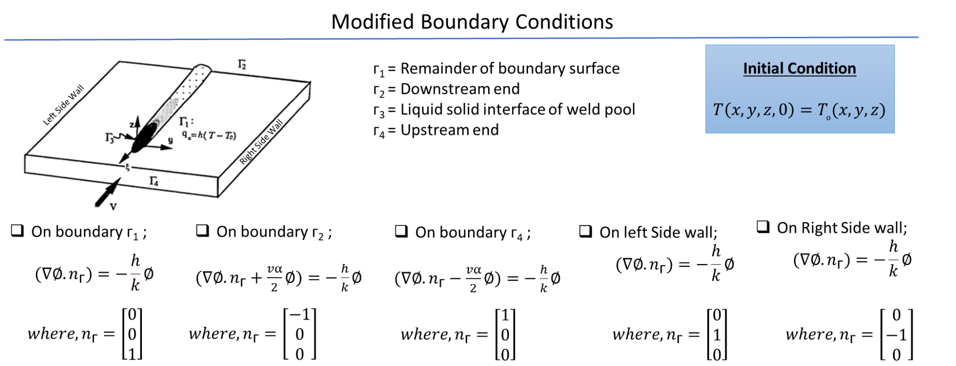

Slide 5
PINN Model
Datasets Used Straight line
Train-Test Split : 80-20
Model Input Layer : [x, zeta, t] Hidden Layer(s) : 16, 32, 16, 8 Output Layer : [phi]
Observations R^2 Value : 0.0

Slide 6
PINN Results
Weights T C I B | Train Loss | Collocation Loss | Initial Loss | Boundary Loss
1 - - - | 6.06716749e+04 8.25694419e+02 | - - | - - | - -
1e-3 1 - - | 6.06716749e+04 6.06829015e+04 | 2.28676361e+08 3.88417866e+00 | - - | - -
1 1 - - | 6.06716749e+04 6.06829015e+04 | 2.28676361e+08 3.88416711e+00 | - - | - -
1e3 1 - - | 6.06716749e+04 6.06829011e+04 | 2.28676361e+08 4.08733232e+00 | - - | - -

Slide 7
PINN Model
Datasets Used Straight line 1D
Train-Test Split : 80-20
Model Input Layer : [x, y, z, zeta, t] Hidden Layer(s) : 16, 32, 16, 8 Output Layer : [phi]
Observations R^2 Value : 0.0

Slide 8
PINN Results
Weights T C I B | Train Loss | Collocation Loss | Initial Loss | Boundary Loss (3 Boundaries)
1 1 1 1 | 1.86419879e+12 1.86419784e+12 | 6.12740194e+09 1.19125747e+04 | 6.72721412e-04 1.65365742e-06 | 3.66143383e+04 3.96430133e+04 4.97256440e-02 7.64982652e-02 7.92347485e-02 7.81244919e-05
Even with different weights the trend remains same.

